Slide 1
Geometric Programming
Ashwin Amalaruban (193020020)
Date:15-06-2020
Instructor: Dr. Mani Bhushan

Slide 2
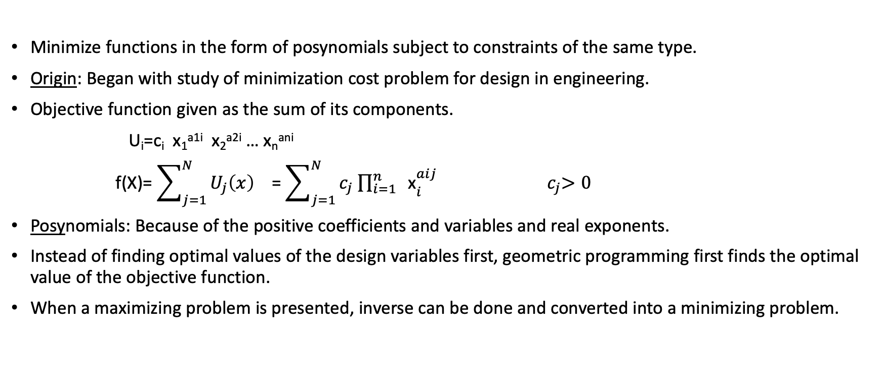
Introduction
Minimize functions in the form of posynomials subject to constraints of the same type.
Origin: Began with study of minimization cost problem for design in engineering.
Objective function given as the sum of its components.
U_{i}=c_{i} x₁^{a1i} x₂^{a2i} … x_{n}^{ani}
f(X)= $\sum_{j=1}^{N}{U_{j}\left(x\right)}$ = $\sum_{j=1}^{N}{c_{j}{ \prod_{i=1}^{n}{ \text{x}}}_{i}^{aij}}$ ${ c}_{j}>0$
Posynomials: Because of the positive coefficients and variables and real exponents.
Instead of finding optimal values of the design variables first, geometric programming first finds the optimal value of the objective function.
When a maximizing problem is presented, inverse can be done and converted into a minimizing problem.

Slide 3
Properties of GP:
Sensitive to the input parameters of the problem.
Strong duality nature
Two approaches
Based on differential calculus.
Based on the concept of geometric inequality.
Degree of difficulty: Difference of no. of unknown’s and no. of equations
D=N-(n+1)
N=n+1 → Unique solution
When N>n+1 → Infinitely many solutions
Geometric programming not applicable for problems with negative D.
Feasible unknown vector need NOT lead to an optimal design x*
Can solve both constrained and unconstrained problems.
N->total number of terms in all the posynomials
n->number of design variables

Slide 4


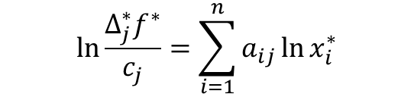


Based on differential calculus:
We define a quantity $Δ_{j}^{∗}=\frac{U_{j}^{∗}}{f^{∗}}$
This relates contribution of the j^{th} term to our optimal objective function.
Function to be minimized
$f^{∗}=\prod_{j=1}^{N}{{\left(\frac{c_{j}}{∆_{j}^{∗}}\right)}^{∆_{j}^{∗}}}$
Normality and orthogonality conditions:
D=0 →Unique solution for $Δ_{j}^{∗}$ → $f^{∗}$
To get optimal variables,
→(1)
→(2)
$$\sum_{j=1}^{N}{Δ_{j}^{∗}}=1$$
→(3)
$$\ln{\frac{Δ_{j}^{∗}f^{∗}}{c_{j}}}=\sum_{i=1}^{n}{a_{ij}}\ln{x_{i}^{∗}}$$
$$\ln{\frac{Δ_{j}^{∗}f^{∗}}{c_{j}}}=\sum_{i=1}^{n}{a_{ij}w_{i}^{∗}}$$
→(4)

Slide 5
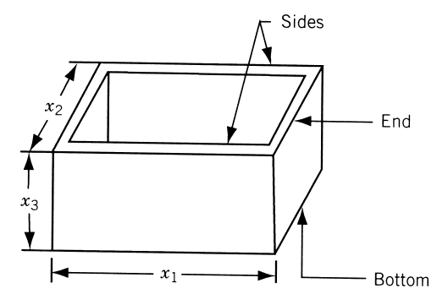
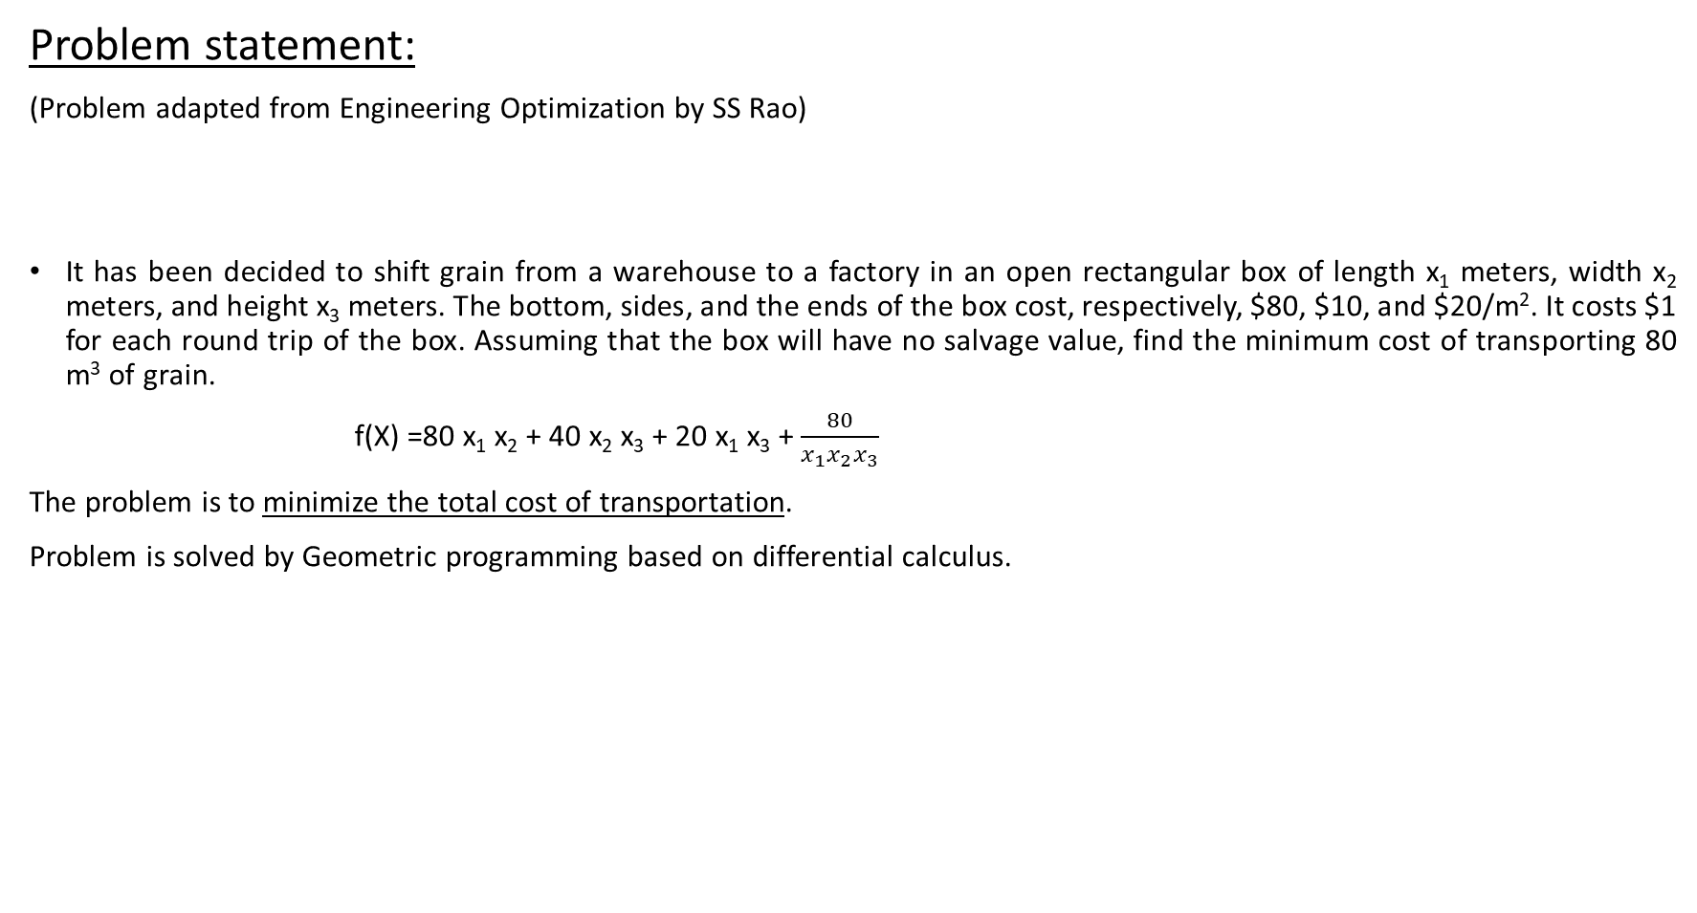
Problem statement:
(Problem adapted from Engineering Optimization by SS Rao)
It has been decided to shift grain from a warehouse to a factory in an open rectangular box of length x₁ meters, width x₂ meters, and height x₃ meters. The bottom, sides, and the ends of the box cost, respectively, $80, $10, and $20/m². It costs $1 for each round trip of the box. Assuming that the box will have no salvage value, find the minimum cost of transporting 80 m³ of grain.
f(X) =80 x₁ x₂ + 40 x₂ x₃ + 20 x₁ x₃ + $\frac{80}{x_{1}x_{2}x_{3}}$
The problem is to minimize the total cost of transportation.
Problem is solved by Geometric programming based on differential calculus.

Slide 6
Results:
Zero degree of difficulty problem → D = N – (n+1) =0 → N=4, n =3
Minimum cost required for transporting 80 m³ of grain and the dimensions of the box to get this minimum value are given.
From our calculation it is observed that x₂ is the reciprocal of x₃.
 |  | Value
Minimized function value | f(x) | $ 200
Variables | x₁ | 1 metre
 | x₂ | 0.5 metre
 | x₃ | 2 metre

Slide 7
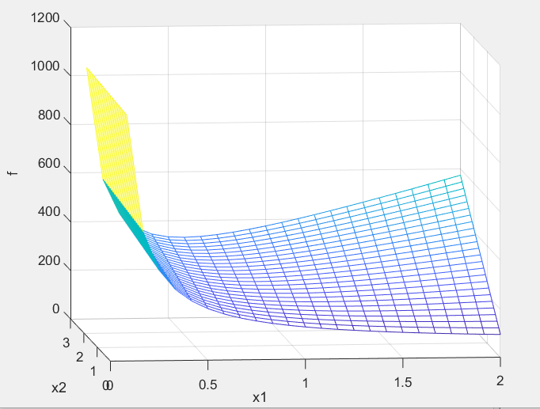
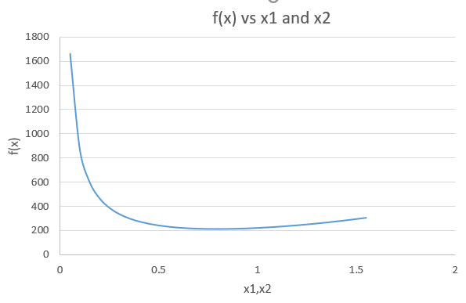
Plot obtained from Matlab and the plot with the one obtained from Excel.

Slide 8
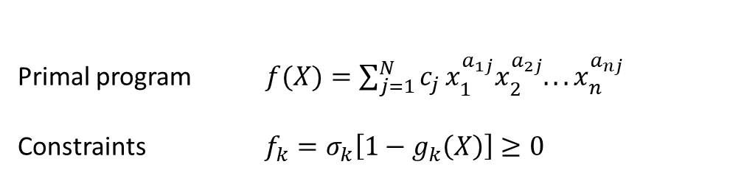

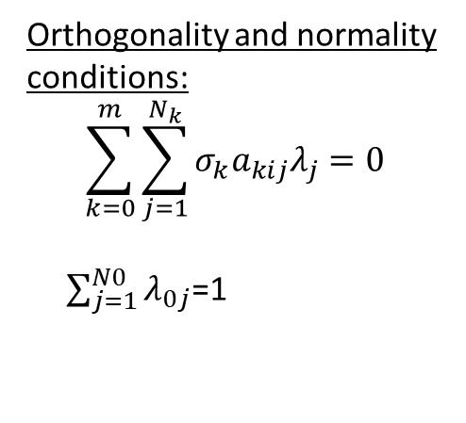
Constrained optimization using geometric inequality:
Maximum of the dual function equals the minimum of the primal function.
f(X) ≥ v($λ)$
Degree of difficulty, D= N –(n+1)
N → number of posynomial terms in the primal function and constraints.
$σ_{k}$ is either +1 or -1 depending on $g_{k}\left(X\right)$.
Dual program
Primal program $f(X)=\sum_{j=1}^{N}{c_{j}}x_{1}^{a_{1j}}x_{2}^{a_{2j}}...x_{n}^{a_{nj}}$
Constraints $f_{k}=σ_{k}\left[1−g_{k}\left(X\right)\right]≥0$
Orthogonality and normality conditions:
$$\sum_{k=0}^{m}{\sum_{j=1}^{N_{k}}{{σ_{k}a}_{kij}λ_{j}}=0}$$
$\sum_{j=1}^{N0}{λ_{0j}}$=1

Slide 9
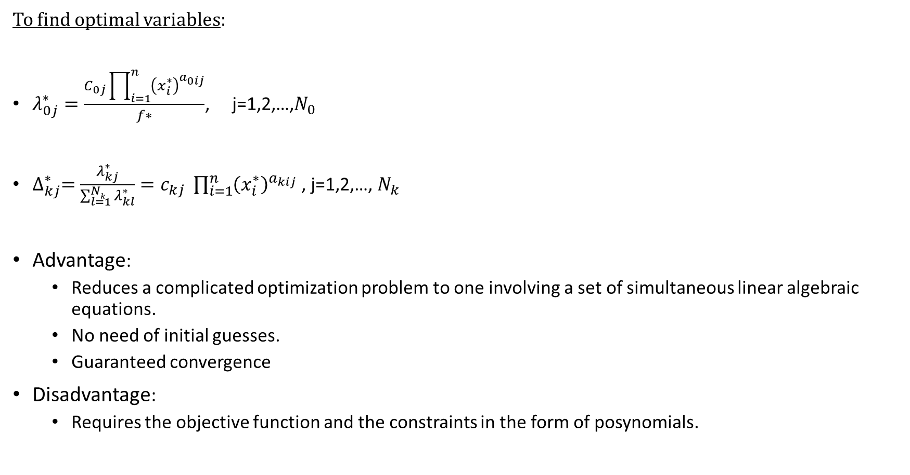
To find optimal variables:
$λ_{0j}^{∗}=\frac{C_{0j}\prod_{i=1}^{n}{{\left(x_{i}^{∗}\right)}^{a_{0ij}}}}{f∗}$, j=1,2,…,$N_{0}$
${∆_{kj}^{∗}=\frac{λ_{kj}^{∗}}{\sum_{l=1}^{Nk}{λ_{kl}^{∗}}}=c}_{kj} \prod_{i=1}^{n}{{\left(x_{i}^{∗}\right)}^{a_{kij}}}$ , j=1,2,…, $N_{k}$
Advantage:
Reduces a complicated optimization problem to one involving a set of simultaneous linear algebraic equations.
No need of initial guesses.
Guaranteed convergence
Disadvantage:
Requires the objective function and the constraints in the form of posynomials.

Slide 10
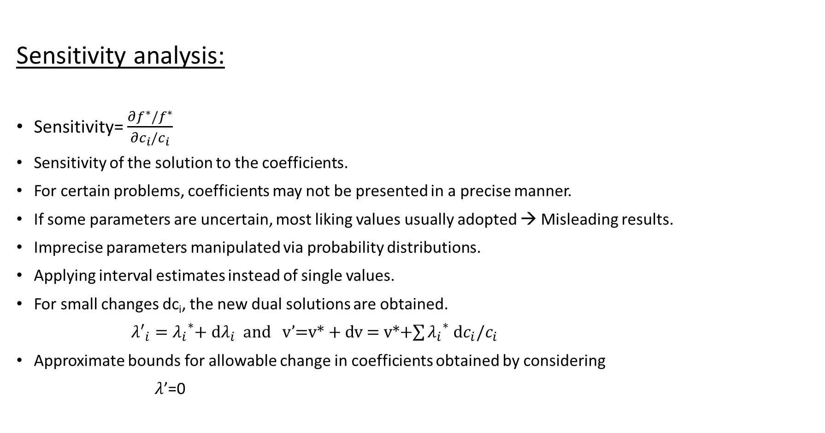
Sensitivity analysis:
Sensitivity= $\frac{∂f^{∗}/f^{∗}}{∂c_{i}/c_{i}}$
Sensitivity of the solution to the coefficients.
For certain problems, coefficients may not be presented in a precise manner.
If some parameters are uncertain, most liking values usually adopted → Misleading results.
Imprecise parameters manipulated via probability distributions.
Applying interval estimates instead of single values.
For small changes dc_{i}, the new dual solutions are obtained.
${λ′}_{i}={λ_{i}}^{∗}$+ d$λ_{i}$ and v’=v* + dv = v*+$\sum{{λ_{i}}^{∗}}$ d$c_{i}/c_{i}$
Approximate bounds for allowable change in coefficients obtained by considering
$λ$’=0

Slide 11

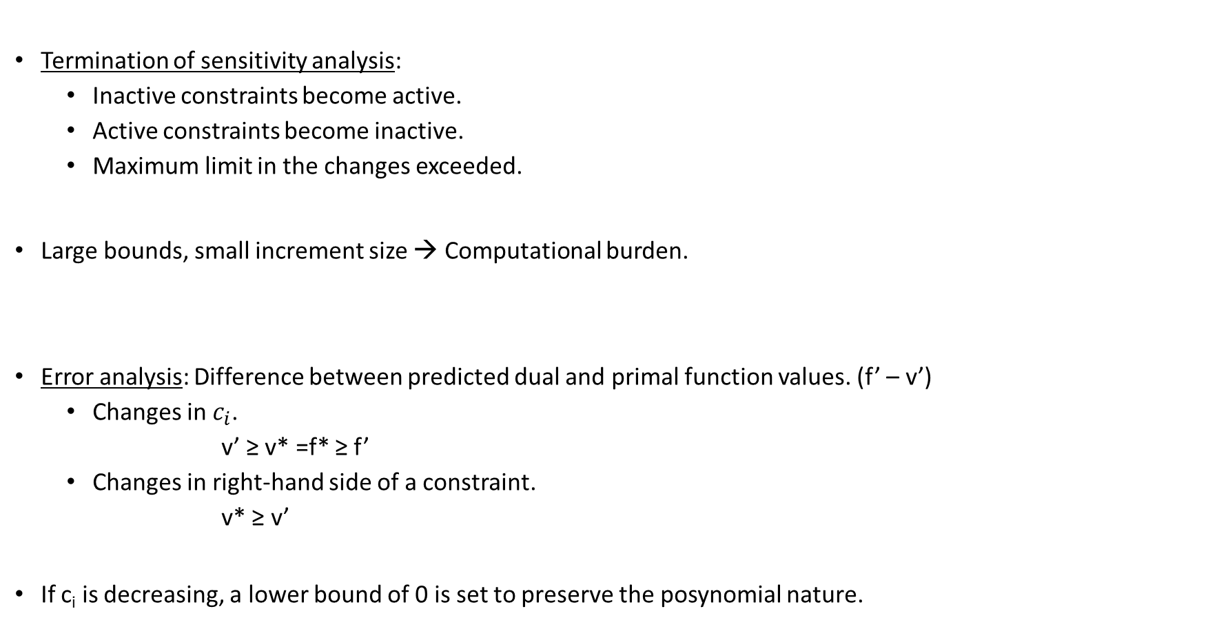
Termination of sensitivity analysis:
Inactive constraints become active.
Active constraints become inactive.
Maximum limit in the changes exceeded.
Large bounds, small increment size → Computational burden.
Error analysis: Difference between predicted dual and primal function values. (f’ – v’)
Changes in $c_{i}$.
v’ ≥ v* =f* ≥ f’
Changes in right-hand side of a constraint.
v* ≥ v’
If c_{i} is decreasing, a lower bound of 0 is set to preserve the posynomial nature.
Increment size = $\frac{{c′}_{i}−c_{i}}{c_{i}}$

Slide 12
References:
[1] Rao, Singiresu S. Engineering optimization: theory and practice. John Wiley & Sons, 2019.
[2] Dinkel, John J., Mary S. Kochenberger, and S. N. Wong. "Sensitivity analysis procedures for geometric programs: Computational aspects." ACM Transactions on Mathematical Software (TOMS) 4.1 (1978): 1-14.
[3] Hoburg, Warren Woodrow. Aircraft design optimization as a geometric program. Diss. UC Berkeley, 2013.
Ojha, Akshay K., and K. K. Biswal. "Posynomial geometric programming problems with multiple parameters." arXiv preprint arXiv:1001.3493 (2010).

